Slide 1

Author : Juanda Lizar
Sentiment Analysis Prediction
Reviews Shoes Sandals Purchased
Sentiment Analysis
Ecommerce Shoes

Slide 2

Understanding
Everyday many products popping into the online market daily, customers depend highly on the customer reviews story of products on eCommerce sites to make decisions about their purchase. Since It will be tedious for the customer to make selection if they should check one by one of the product they needed. Here comes 'reviews' where customers who have already got that product leave a rating after using them and brief their experience by giving reviews. Based on the reviews given by the user, the products can be recommended to another user.
What is the results obtained ?
What is the characteristics customer review by ratings ?
What is the top biwords characteristics reviews for postive ?
What is the top triwords characteristics reviews for negative ?
By using Sentiment analysis, can we predict sentiment reaction by reviews customer ?

Slide 3
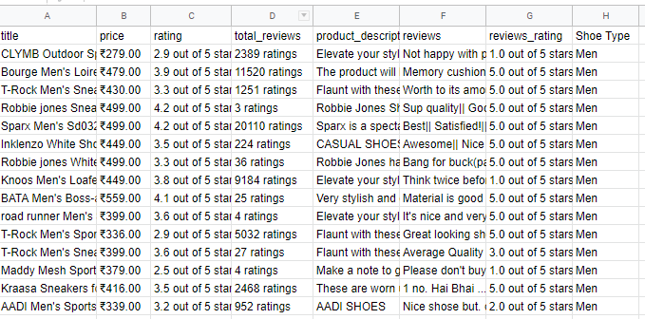
Data Introduction
This dataset is based on e-commerce data set men and woman shoes from kaggle.
Column contains :
Title, Price, average rating, Product Description, Shoe Type
Rating - average rating ( out of 5 ).
Total Reviews - Number of reviews that mobile got on that Product
Reviews - Contains up to 10 reviews of Shoe ( separated by '|| ')
Reviews Rating - Contains up to 10 corresponding reviews rating of Mobile ( separated by '|| ')
Sentiment analysis will focus for column Reviews and Reviews Rating

Slide 4
Data Preparation
This is about for prepare dataset for sentiment analysis, such as extraction review and review rating from the source and process to be Exploratory Data Analysis and Modelling
Stage 1
Stage 4
Splitting reviews and reviews rating at new data set
Missing value will be dropped since we will select only with comment
Stage 2
Stage 5
Cleaning them for their separator (||) since we will take all value among the separator
Define new column sentiment
Stage 3
Cleaning for :
lower at all
from punctuation
Stopwords
Emoji
Symbols
Ambil angka

Slide 5
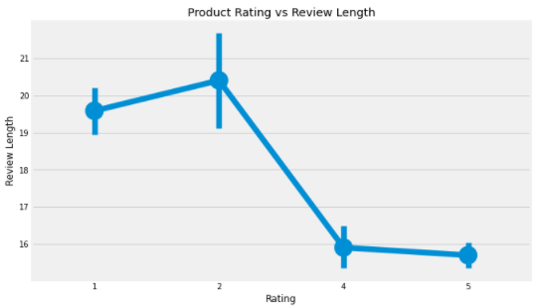
Exploratory Data Analysis - 1
What is the characteristics customer review by ratings ?
When rating between 1 and 2 (as negative), review length significanty goes up, especially for rating 2 as top level, meaning when customer were not happy, they will write too much
When the rating is between 4 and 5 stars (as sentiment positive), with 5 stars as the shortest, review length significantly goes down, meaning Reviews with 4-5 stars are not very wordy. So, when customers were happy, they didn’t write too much!

Slide 6
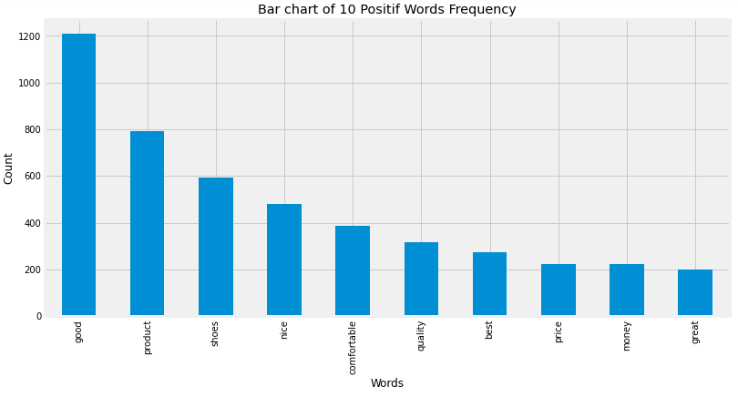
Exploratory Data Analysis - 2
What is the top biwords characteristics reviews for postive ?
We can observe :
If we want to see expression word positive, Good as the most frequent words to show customer satisfied expression, then followed nice, comfortable, best and great.
Quite impress for words such as product, shoe, quality, price, and money, showed as the top frequent. Seems to be representative for our product that capable to satisfy our customer in quality and price
We will see biwords to see in detail for positive

Slide 7
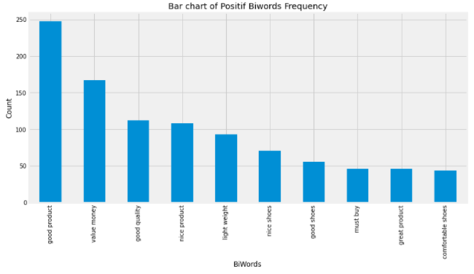
Exploratory Data Analysis - 2
What is the top biwords characteristics reviews for postive ?
I take insight from biwords since i feel need to know a word after expression word positive whether explain expression about product or service. Based on above, We can observe :
Correct, the whole of expression word positive describing for product and price. From chart : good product, value money, good quality, nice product, light weight etc in top biwords illustrated customer happy for product and quality.

Slide 8
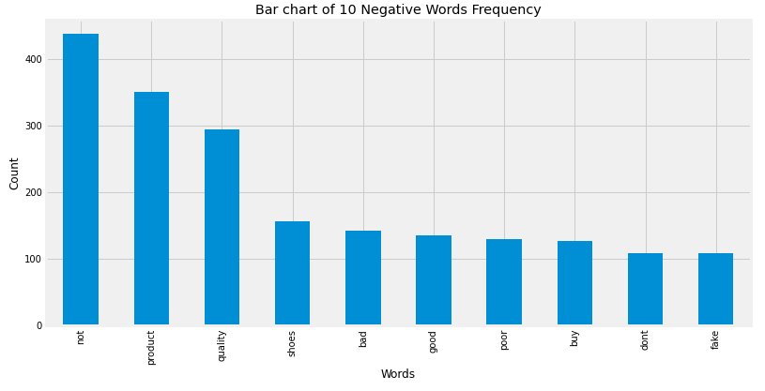
Exploratory Data Analysis - 3
What is the top word characteristics reviews for negatif ?
We can observe :
If we want to see expression word negative, not as the most frequent words to show customer disappointed expression, then bad, poor, and dont comfortable, best and great.
Also Quite impress for words such as product, shoe, quality, buy, good and take the top frequent. Seems also to be representative for our product that not able to satisfy our customer in quality.
We will see triwords to see in detail for negative expression. This is also as per EDA-1 if customer not happy, they will write too much.

Slide 9
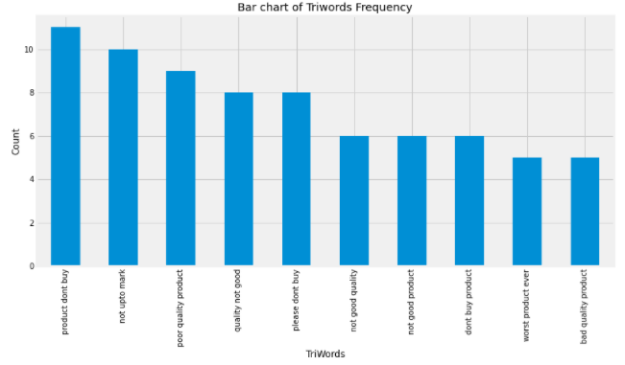
Exploratory Data Analysis - 3
What is the top triwords characteristics reviews for negatif ?
We can observe :
Product dont buy as the most frequent triwords negative. Seems to be the first thing to do for customer negative that isnot given recommen about product.
up to mark, poor quality product etc. these expression showed the product below standard or expectation
These expression negative comment is really critical to business to check the product in details. If the product selling by seller or distributor, can give them alert for their product. So they can change negative to positive

Slide 10
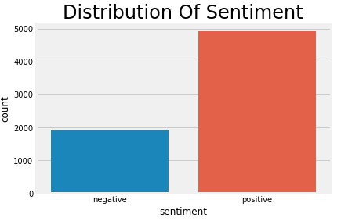
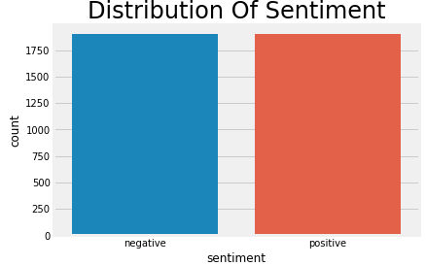
Modelling
Classification model only into 2 groups positive and negative : reviews rating 1-2 will be labeled negative, reviews rating will be score 4-5 will be labeled positive while rating 3 will be dropped since they are neutral.
The classification model used is the SVM model
handling imbalance data by resampling, resampling doing equally representative of all classes, sample taken is 1900 data on each label.
Before sampling
After sampling

Slide 11
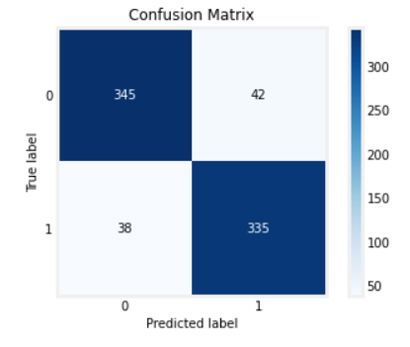
Modelling
From the Confusion matrix, we can see the sum of
True Positive = 345, sentiment which was predicted positive and is actually Positive
False Positive = 42, sentiment which was predicted as positive, but is actually negative, or in simple words the note wrongly predicted as sentiment by our Model
False Negative = 38, sentiment which was predicted as negative, but is actually Positive
True Negative = 335, sentiment which was predicted negative and is actually Negative

Slide 12
Modelling
Classification Report | Score
F1-score | 89.33%
Accuracy score | 89.47%
Precision score | 88.86%
Recall score | 89.81%
From the Classification Evaluation Metrics above, we can see our model performance
Since we handled already imbalance data with sampling then our data are nearly balanced. Seem to be make the whole value of evalution metrics have close values.
In this case, since our data are nerly balance, we use accuracy rate of 89.47 to describe best performance our model. Meaning our sentiment classifier is doing a great job of identifying reviews

Slide 13
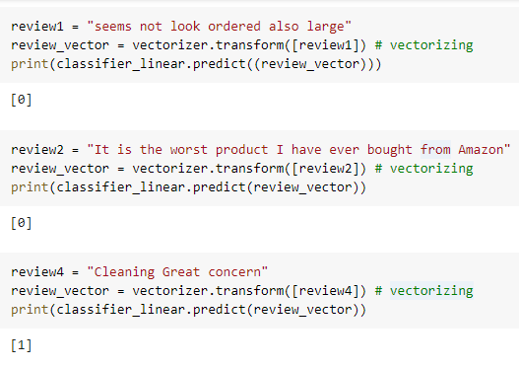
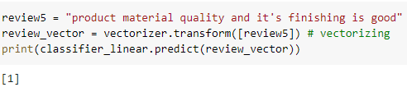
Modelling Test

Slide 14
Business Recommendation
Sentiment analysis learn us
Immediately checking for products that have negative reviews than give alert to seller or distributor to improving their product. So can change negative to positive soonest.
Our customer characteristics by review, if they unhappy (negative), they will write too much for reviews and while they happy, they are not very wordy, not write too much. As a tribute to customer review as well as improving our service to them, we can consider to give point discount for every single review customer. So we can keep control our product selling by review customer.

